Slide 1
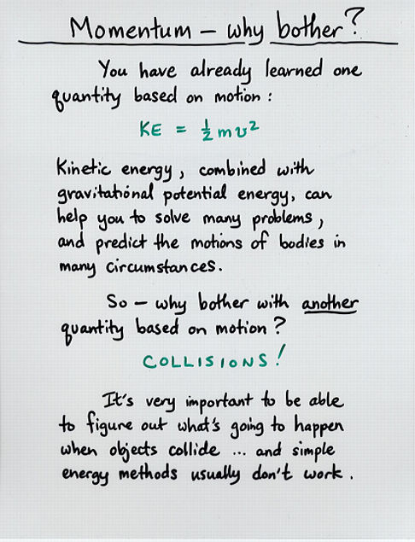


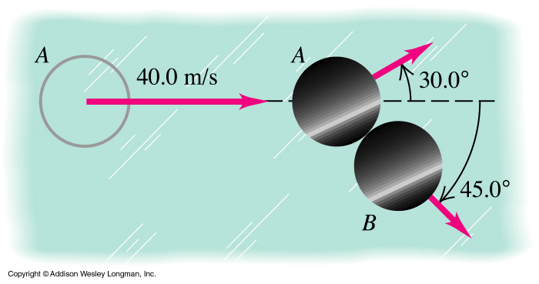
Momentum
Physics 131
Lecture 13
Momentum
Impulse
Conservation of momentum
All found in Young and Freedman, University Physics, chapter 8, sections 1 to 3
Notes:
People talk about momentum ….a bat has momentum or momentum of cars…. We’ll talk about wxactly what momentum is.,.
Impulse screw drivers are in … what does this term inpulse mean?....Inlcuding How it is derived from Newtons Second Law.
Demo…… Hammer……
If I rest a hammer on a nail.. It exerts a force due to its weight… why doesn’t it push the nail in??.....
Then conservation of momentum…. Momentum is always concerved in collisions. ….
Here’s a list of what you need to know from this lecture. You have this information on the handout I have given you. The handout also includes the text book references.

Slide 2
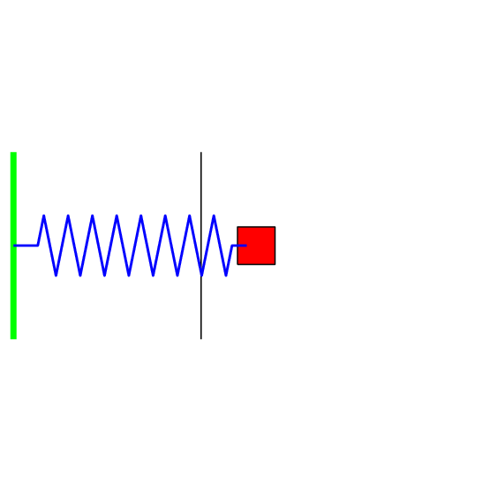
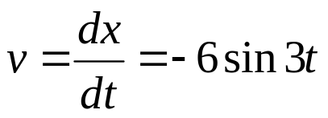
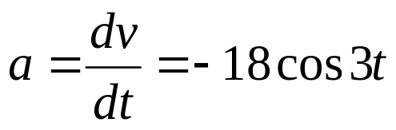
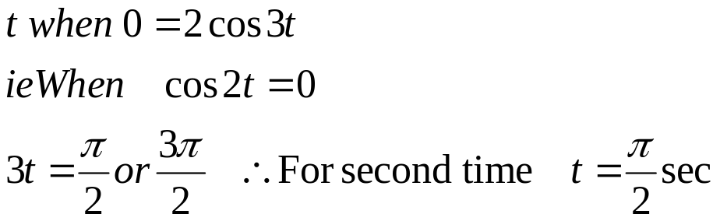
Review
Have a mass obeying a Simple Harmonic Motion equation according to he position equation x = 2cos3t
Derive the velocity equation.
b. Find the equation for acceleration of the mass
c. What is the maximum amplitude?
d. Find the second time that the mass will be at position zero.
Notes:
Demo- steel and rubber hammers

Slide 3
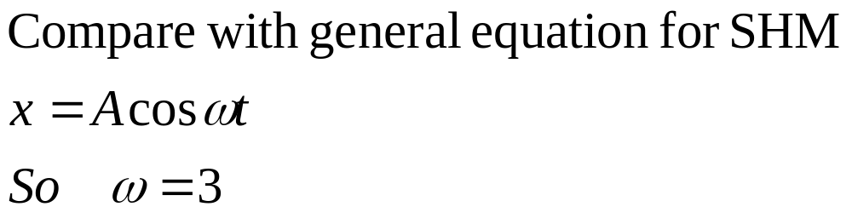
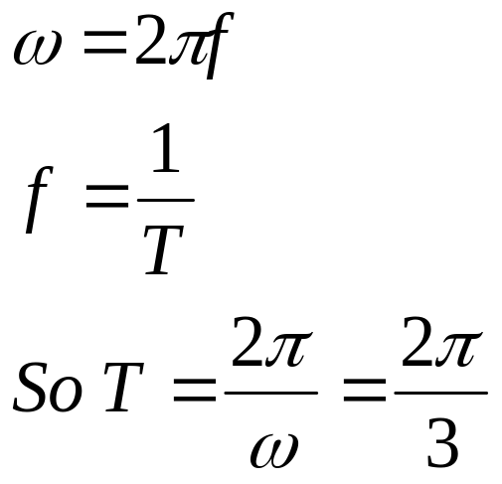
Period of oscillation T
x = 2cos3t
For the previous example What is the period T of oscillation if the mass is 2.5 kg.

Slide 4
Linear momentum
Momentum is a measure of how hard it is to stop a moving object; it is the product of the object's mass and its velocity; since velocity is a vector, momentum is a vector quantity; symbol is p and SI unit are kg m/sec. The direction of the momentum is the same as that of the velocity. For example, a ball is thrown at a wall, which stops it. The ball exerts a force on the wall equivalent to its momentum change. If you know the mass of the ball and the original velocity of the ball, you can calculate the momentum change. If you know the length of time it took to stop the ball, you can calculate the force on the ball.
Linear momentum is defined as
p = mv
S.I. Units for momentum are kg m/s
Momentum is a vector- so has direction
Notes:
So what is linear momentum ? It is defined as the product of mass of an object times its velocity. Given the symbol p and its SI units are kg m/s.

Slide 5
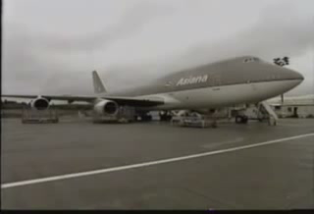
Too much momentum p

Slide 6
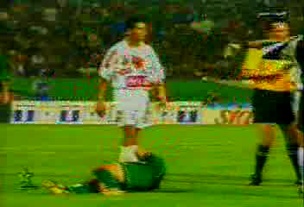
Notes:
Not enough momentum

Slide 7
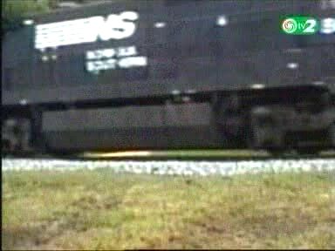

Slide 8
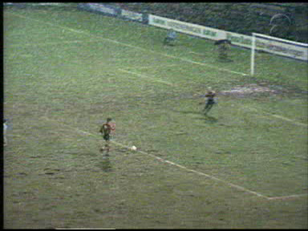
Too little momentum

Slide 9
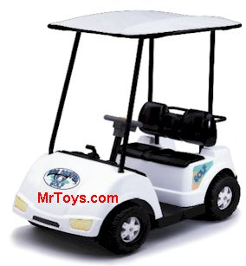
Example: Finding momentum
Find the momentum of a 170 kg golf if the handbrake fails and it rolls down a hill at 20 km/hour.
p = mv
=170x20/3.6 = 944 kg m s⁻¹

Slide 10


Impulsive force = rate of change in momentum
Newton’s second law states that
Therefore
But p = mv and so J=Ft = Δp
Can see that an alternative unit for momentum is Ns
Notes:
We Can use Newton’s second law to find a relationship between force and this quantity linear momentum.
Thus Newton’s second law says that the net force acting on a particle equals the time rate of change of linear momentum.

Slide 11

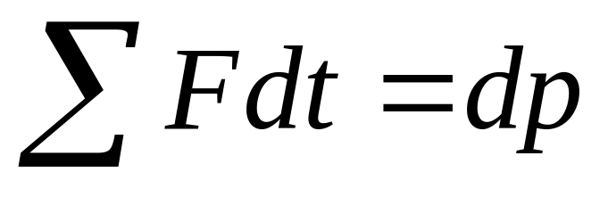
Impulse-momentum theory
The change in momentum of a particle during a time interval equals the impulse of the net force that acts on the particle during that time interval
J = p₂- p₁=Δp
= Impulse J
Notes:
Another useful quantity is one called impulse, J. It is simply the change in momentum. It is defined by the impulse-momentum theory which states that “The change in momentum of a particle during a time interval equals the impulse of the net force that acts on the particle during that time interval”. Important to remember that it is not a force. It is actually force times time. (can see from F=dp/dt)
Comes from our F=dp/dt, hence Fdt=dp = impulse.
So can calculate the impulse of a force either by looking at net Force times time applied or change in momentum.

Slide 12
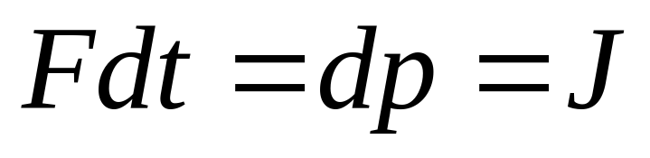
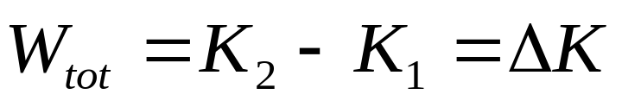
Momentum and kinetic energy
The impulse-momentum theory shows that any changes in momentum are due to an impulse which depends on the time over which the net force acts.
J = p₂- p₁
The work-energy theorem tells us that kinetic energy changes when work is done on an object and work depends on the distance over which force acts
F . ds = W
Notes:
This helps us to see the difference between momentum and kinetic energy. Both have mass and velocity in them, one has velocity to the power of one and the other has velocity squared. But what about a physical difference ?
The impulse-momentum theory shows that any changes in p are due to an impulse (J=delta p). This is related to the length of time over which a force is applied (change in momentum=J = F t).
From work-energy theorem see that kinetic energy changes depend on the distance over which force acts (change in ke = work done = Fs).

Slide 13
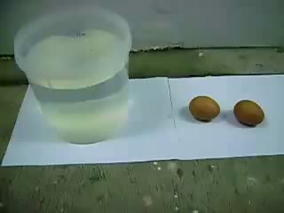

Slide 14
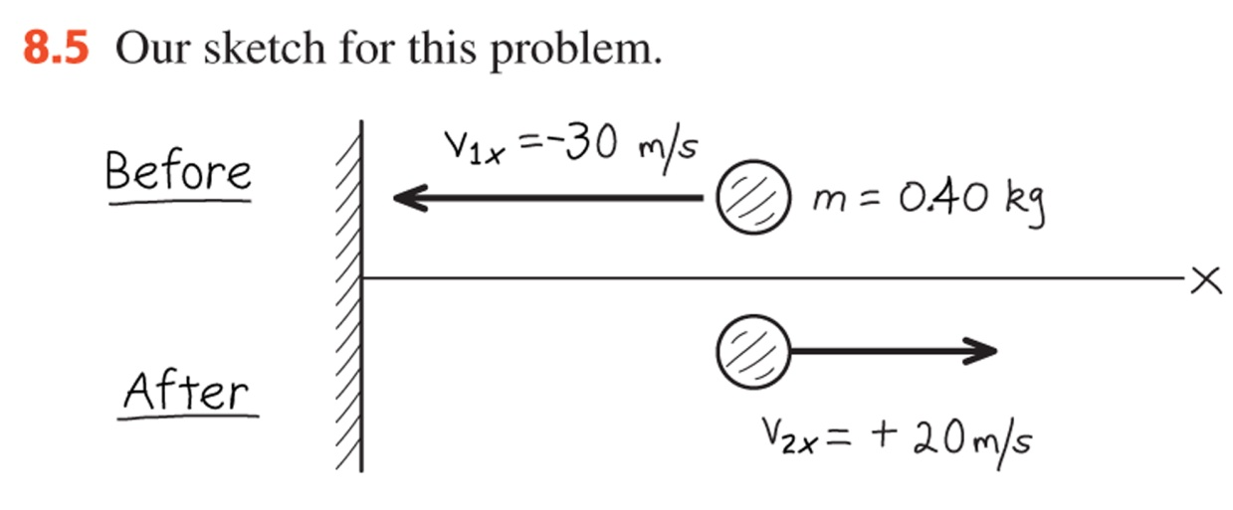
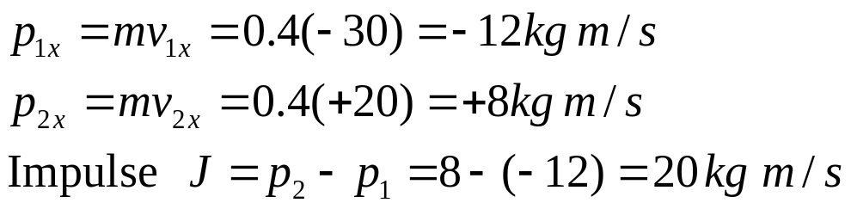
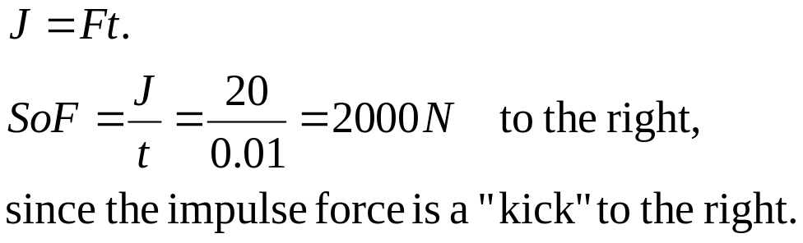
Example 8.2 Momentum and Impulse
A ball with mass 0.4 kg is thrown against a brick wall. It hits the wall moving horizontally with a velocity to the left of 30.0 m/s. It rebounds horizontally to the right at 20.0 m/s.
Find the impulse of the net force on the ball during its collision with the wall.
b) If the ball is in contact with the wall for 0.01 s and assuming that the net force is constant, calculate the horizontal net force that the wall exerts on the ball during the impact.
Notes:
Let’s do an example involving momentum and impulse..ball against a wall

Slide 15
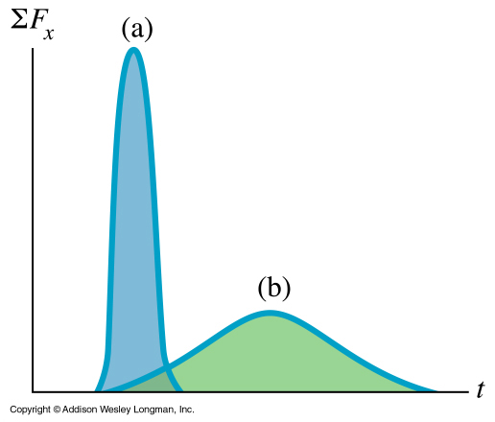
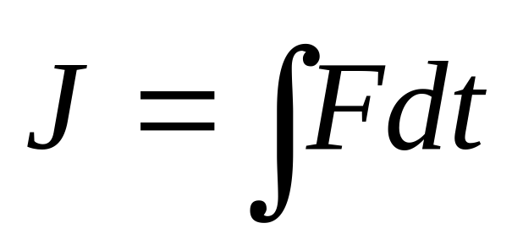
Different types of impulses=area under curves
“hard” collision, such as golf ball
“soft” collision, such as tennis ball

Slide 16
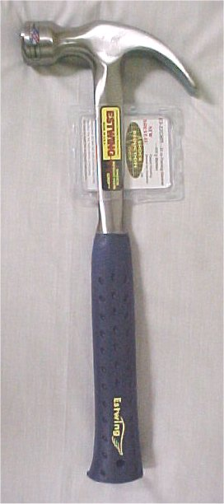
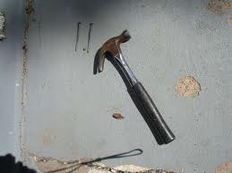
Impulse- with large Force
Force
Made to impulse- high force over very short time
time
Notes:
Hammering nails- provides a very large force over a small time……
The impulse is the area under the curve….

Slide 17
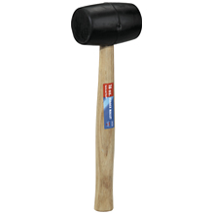
Impulse- with smaller Force
Rubber hammer
Made to impulse- low force over longer time
Force
time
Notes:
Provides a small force over a larger time……same size of impulse….area under the curve

Slide 18
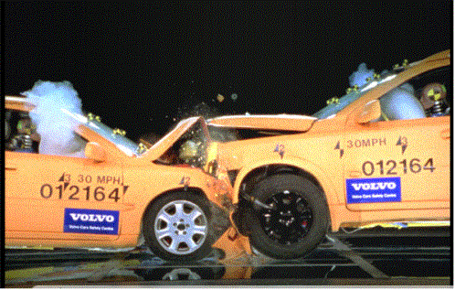
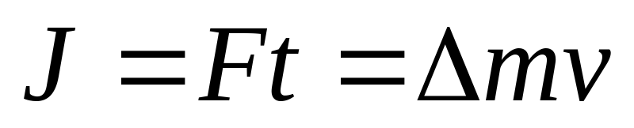
Impulse and Cars
Cars are designed to reduce the force in the impulse for the occupants - by increasing the time over which the force in collisions act.
How do they do this?....
Seatbelts- do more than just hold a person… they also reel out slowly.
Airbags- secondary system to slow a person.
Cabin design-reduce sharp objects and keep stable
A bonnet capable of collapsing- engine should move under car.

Slide 19

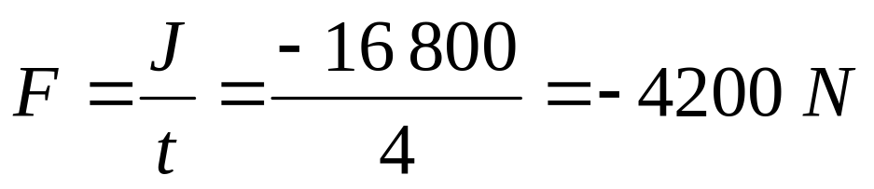
Impulse on a car
Mr Bean is driving along in his Mini with total mass 800 kg at 21m/s, and spots an old lady about to cross the road. He slams the brakes on and stops in 4 seconds. What is the total impulse during this time?
What is the total force needed to stop the car?

Slide 20
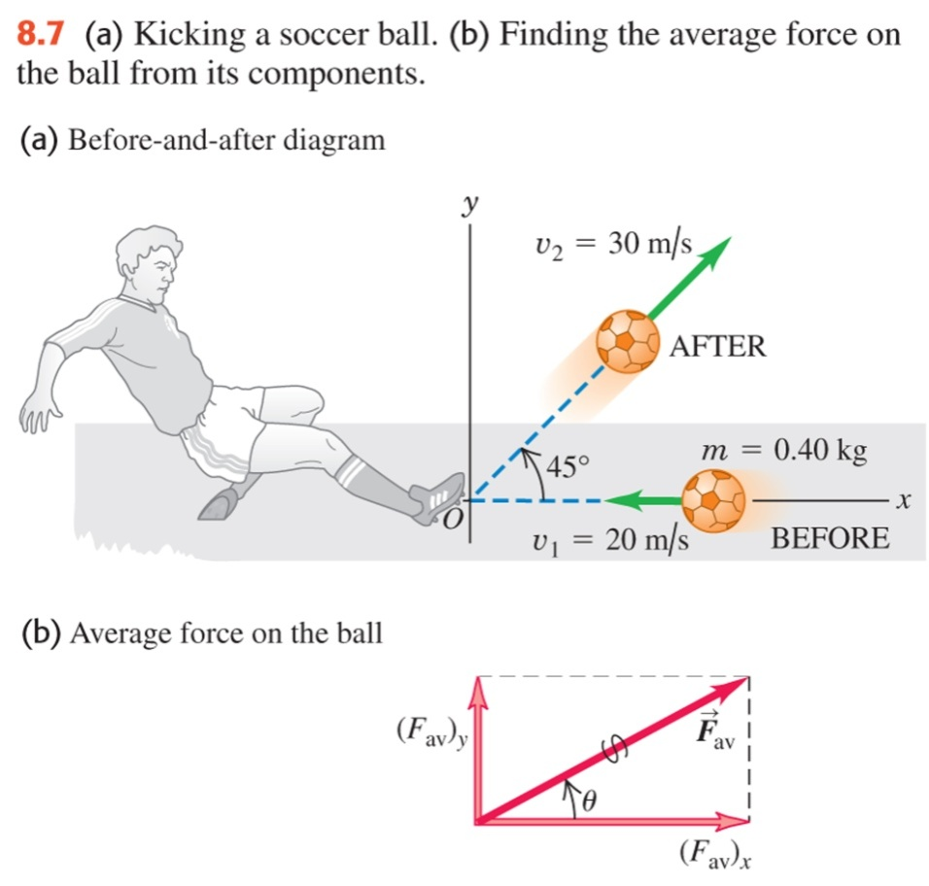
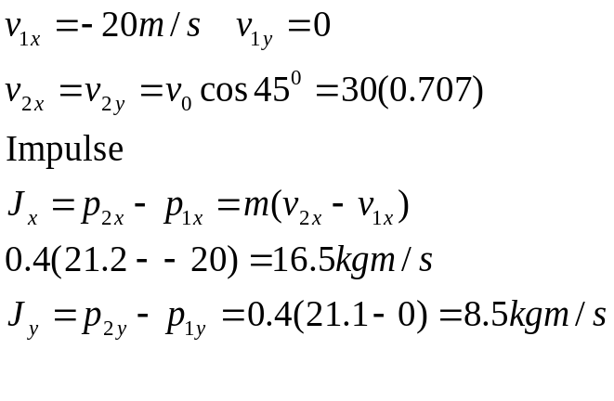
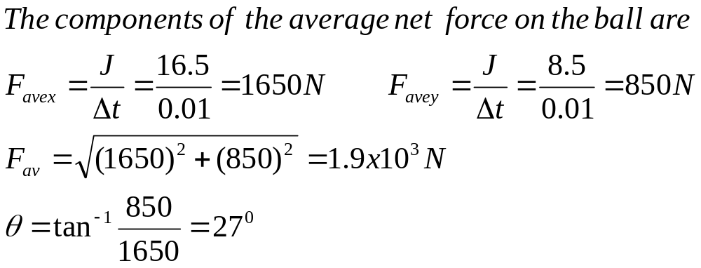
Example 8.3 Kicking a soccer ball
A soccer ball has a mass of 0.4 kg. Initially, it is moving to the left at 20 m/s, but then it is kicked and given a velocity at 45⁰ upward and to the right, with a magnitude of 30 m/s.
Find the impulse of the net force and the average net force, assuming a collision time Δt=0.01sec.

Slide 21
Conservation of momentum
If the vector sum of the
external forces on a system is zero,
the total momentum of the
system is constant in any collision. Σp=0
Notes:
Momentum is always conserved in collisions.
So if no external forces acting- momentum total momentum before a collision always equal total momentum after collision.
@
In this mpeg- the two cars were lucky to avoid a collision…….But if they had collided- total momentum before = total momentum after….
So momentum is concerved…
So in this mpeg if we had added up the momentum of the cars before…. And then again after…. Will be the same.

Slide 22
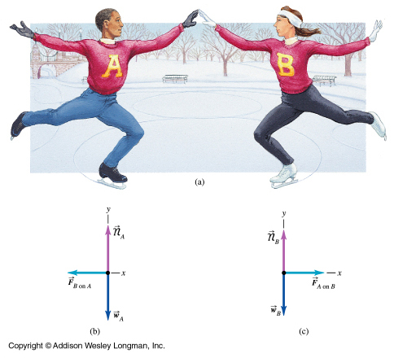
8.2 Conservation of momentum
Notes:
Demo air tracks or two cars …. .
The conservation of momentum says that if two objects collide-… the total momentum before and after is still the same….
So if these dancers have zero total momentum initially….. They push each other- they both are propelled away from each other with equal momentum… so that the total momentum still ===zero… This doesn’t mean they have the same velocity…… same momentum mv….
Let’s take a look at a couple of examples to see how this works.

Slide 23

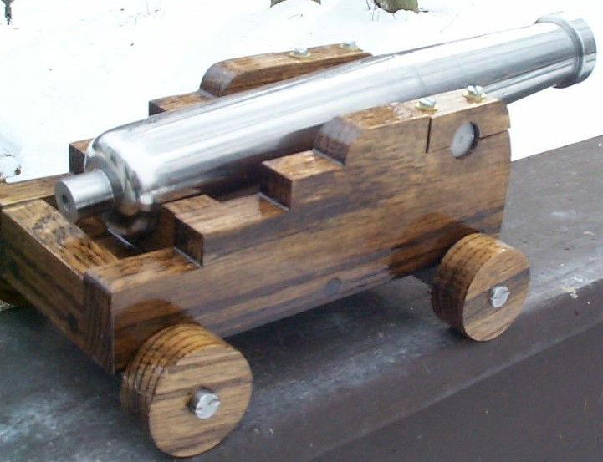
Recoil of guns/cannons= conservation of momentum
Mr “Smith’s gun recoiled
Commander and master- cannons recoiled well
Notes:
Remember in MIB when “Mr Smith” Wasn’t pleased when he was given a small gun. …. However the recoil indicated that it fired something pretty potent …..as it did….
Russel Crowes film….Commander and master…… At sea-was a very well considered film to be authentic…. Cannons recoiled well…….

Slide 24
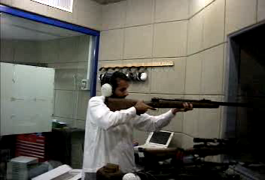

Slide 25
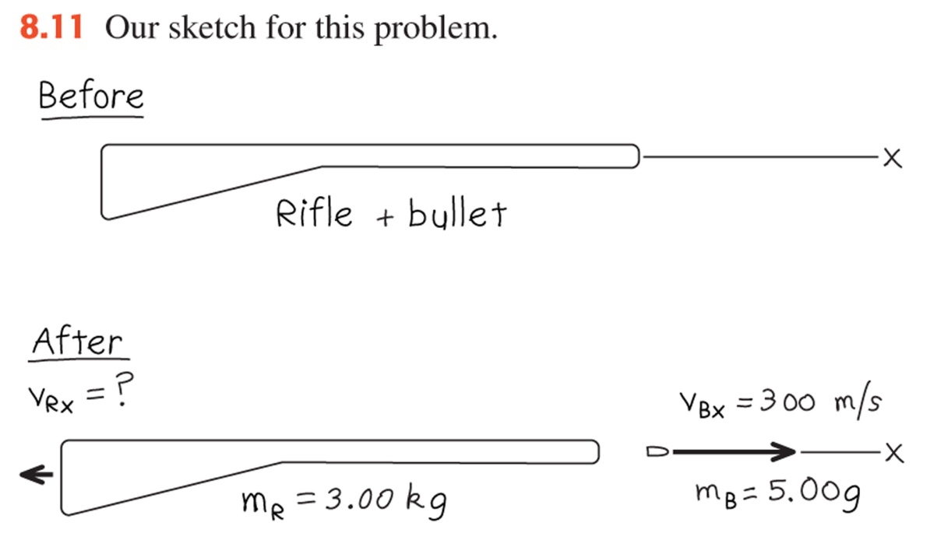
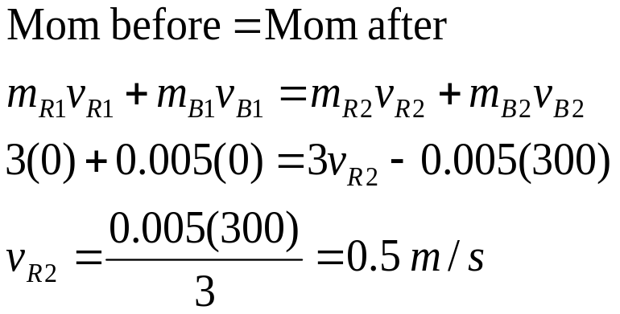
Example 8.4 Recoil of Rifle
A marksman hold a rifle of mass m_{R}=3.00 kg loosely in his hands, so as to let it recoil freely when fired. He fires a bullet of mass m_{B}=5 g horizontally. The bullet travels at 300 m/s. What is the recoil velocity of the rifle?
Notes:
MIB When that small gun was fired he was thrown backwards.
Has anyone fired a shotgun……if it doesn’t rest against your shoulder when fired- it can injure your shoulder…
Shotguns do this because of the fairly large mass of all the lead shot- though for most guns- even fast ones- the recoil is manageable.

Slide 26

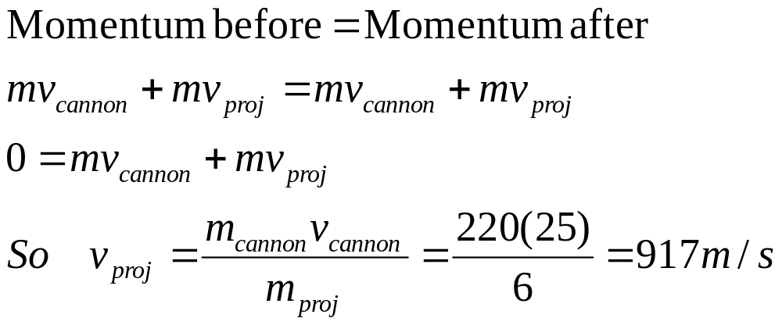
Cannons recoil velocity
A cannon fires cannon balls of mass 6 kg, horizontally. The initial recoil velocity of the barrel of mass 220 kg is 25m/s.
Find the initial velocity of the projectile.
Notes:
If you look closely at a cannon- they all have recoil springs- to absorb the recoil momentum of the cannon….
If you look closely at old cannons- they leap backwards…. New cannons use a spring and just the barrel moves backward…..
The impulse is still the same- though the spring increases the time over which it affects the rest of the cannon----so lowers the recoil force on the rest of the cannon…..
In reality though cannons fire a large cannon ball a few kg at least at a high velocity… because of fairly large mass of ball and very large velocity there has to be an equal amount of momentum after the ball is fired….
You can see this on films the cannons themselves shoot backwards… there could be a spring or wheels or chains to stop the cannon moving backward……

Slide 27
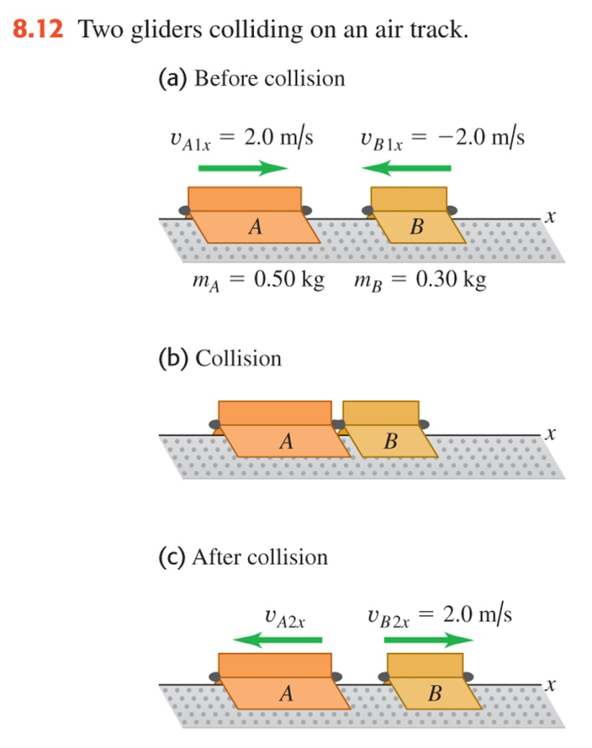
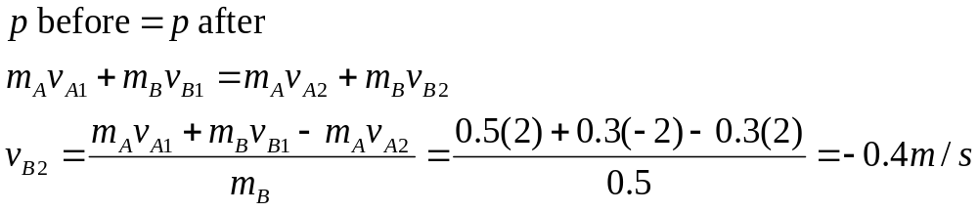
Example 8.5 Conservation of momentum
Two gliders move toward each other at 2.0 m/s on a frictionless linear air track. After they collide, glider B moves away with a final velocity of +2.0 m/s. What is the final velocity of glider A ?
Notes:
Two gliders move toward each other on a frictionless linear air track. After they collide, glider B moves away with a final velocity of +2.0 m/s. What is the final velocity of glider A ?
Here there is no net external force…nothing is pushing on the gliders and there’s no friction. So we can apply our total momentum before = total momentum after.

Slide 28
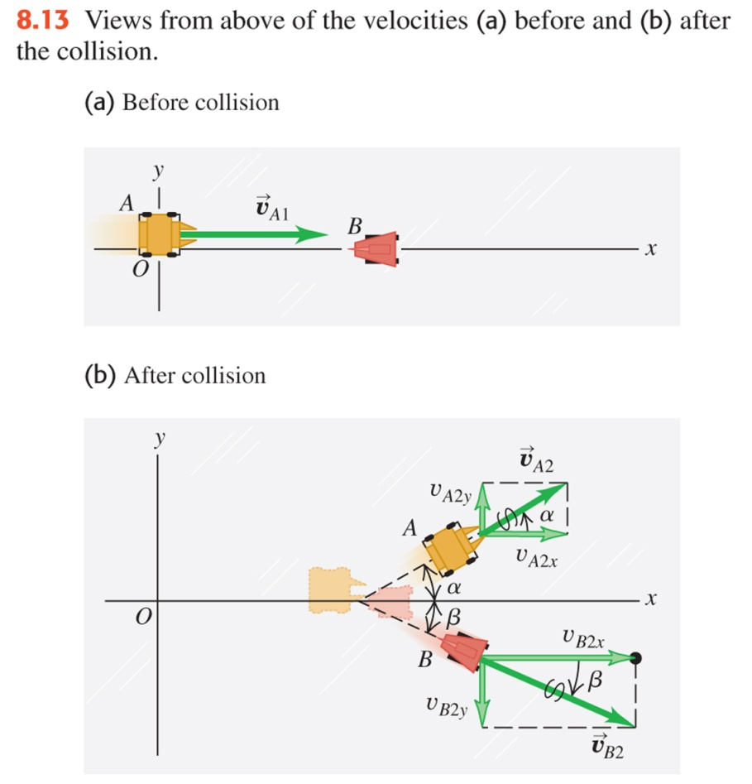
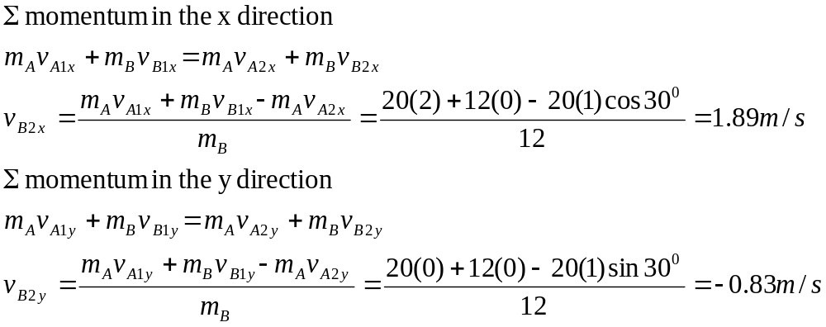
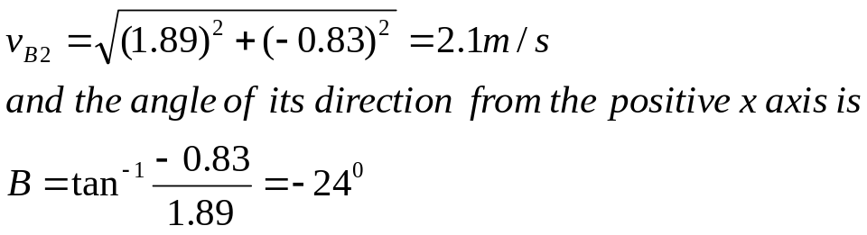
Example 8.6 Conservation of momentum
Two chunks of ice slide on a frictionless frozen pond. Chunk A, with mass 5.0 kg, moves with initial velocity 2.0 m/s parallel to the x-axis. It collides with chunk B, which has a mass 3.0 kg and is initially at rest. After the collision the velocity of chunk A is found to be 1.0 m/s in a direction making an angle of 30⁰ with the initial direction. What is the final velocity of chunk B ?
Notes:
This can be extended to 2-D problems….momentum can be separated into its x and y coordinates and so we can look at conservation of momentum in each one of these dimensions. Lets do an example.

Slide 29
